Slide 1

Anime Rating Analysis
Prediction of Anime’s Rating
Dipanka
Talukder

Slide 2

Objective
The objective here is to perform regression analysis and to develop a model that can be used to predict the ratings received by the enlisted anime releases, such that, in the future, the anime production studios can develop their strategies which can improve the rating.

Slide 3

Analysis Process
Steps implemented in this analysis
Pre-processing the dataset
Explanatory Data Analysis by Visualization
Model Building and validation of test results
Statistical inference and business insights.

Slide 4

Dataset and Data Pre-processing
In this part, we will understand the dataset, check for missing values and presence of outliers in our dataset.

Slide 5
Dataset
The dataset contains details of 7029 Animes based on 16 columns which are the predictor variables for our analysis.
Data Dictionary
Rating: Average user rating given by the viewers for the anime releases.
Title: Name of the anime releases.
Media Type: Format of publication of the anime releases (Web/DVD special/Movie/TV special/TV).
EPS: Number of episodes (movies are considered 1 episode).
Duration: Duration of each episode (in minutes).
Ongoing: Whether the anime is ongoing or not (Yes/No).
Season Of Release: The season of release of the anime (Winter/Spring/Fall/Summer).
Description: Synopsis of plot of the anime.
Studios: Studios responsible for the creation of different anime.
Tags: Tags, genres, etc. of different anime.
Content Warn: Content warning provided for the different anime.
Watched: The number of users who completed watching it.
Watching: The number of users who are watching it.
Want Watch: The number of users who want to watch it.
Dropped: The number of users who dropped it before completion.
Votes: The number of votes that contribute to the ratings received by different anime.

Slide 6
Data Pre-processing
Removal of Useless Column: Column such as Title, description, studios and tags are not useful data for our analysis so we can drop this column for further analysis.
Missing Value Treatment
Treatment of Outliers
Columns like season of release and content warn have more than 30% of the missing value therefore discarded.
Watched column have 1.2% of missing values and replaced with median value.
Duration column have 24.1% of missing values and replaced with median value.
Media Type column have 0.4% of missing values and replaced with mode value.
We have outliers in the columns like: EPS, Duration, Watched, Watching, Want Watch, Dropped, Votes.
Presence of extreme values in the above mentioned columns.
Percentile method used to replace the outliers.

Slide 7

EDA & Visualization
It is conducted for Univariate and Bivariate analysis of the predictor variables.

Slide 8
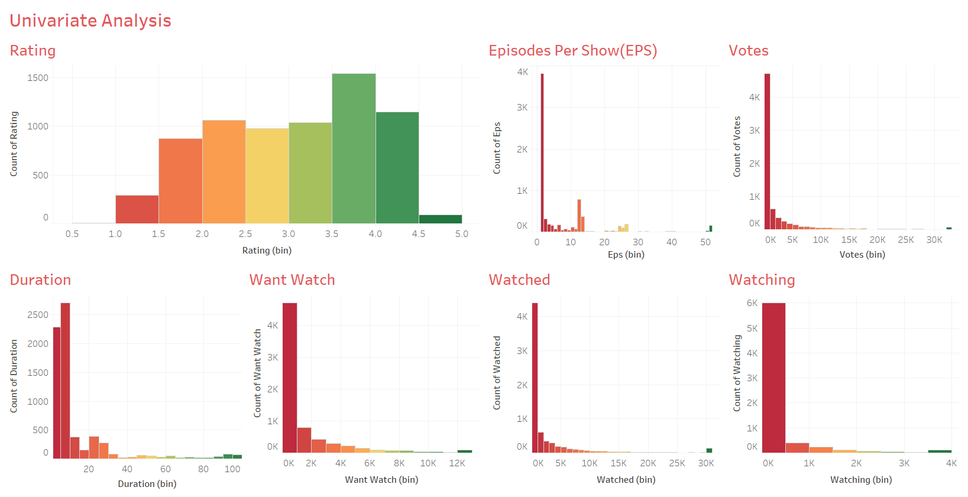
Univariate Analysis

Slide 9
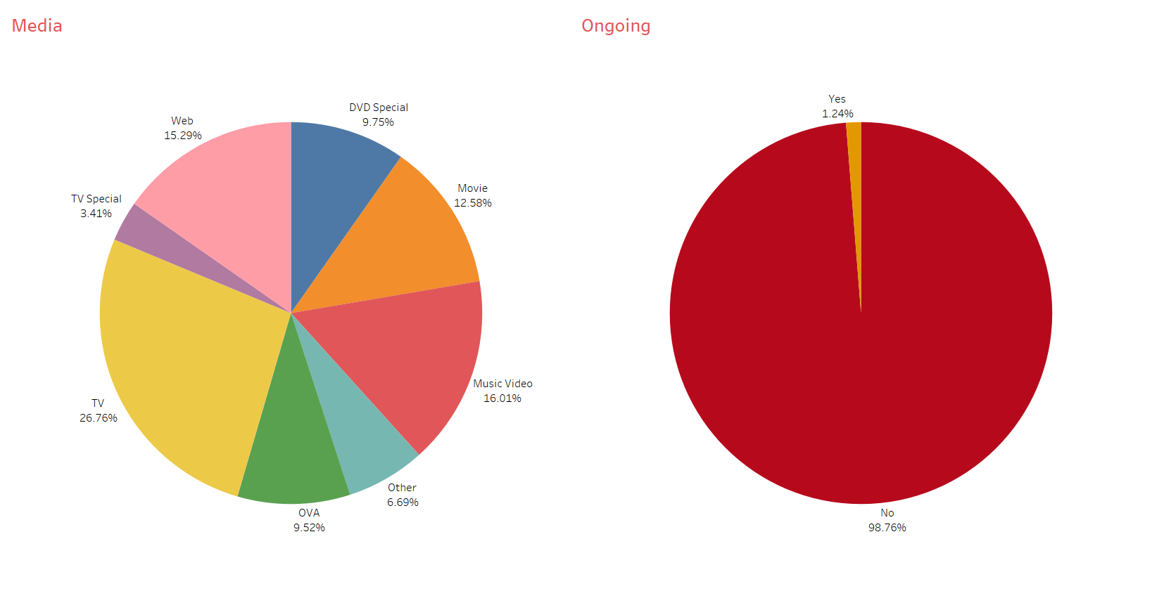
Univariate Analysis

Slide 10
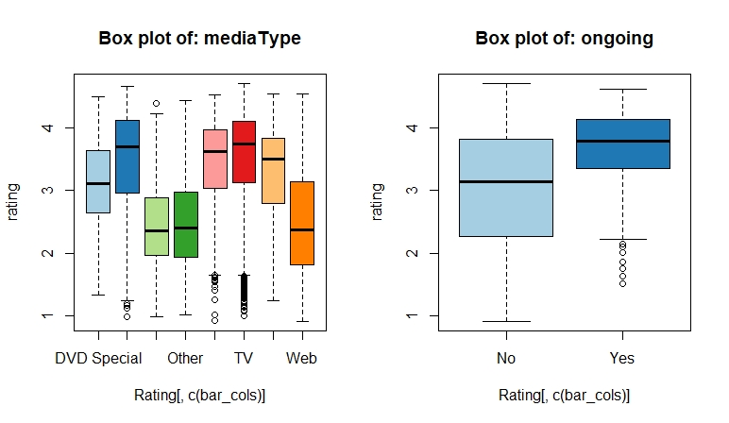
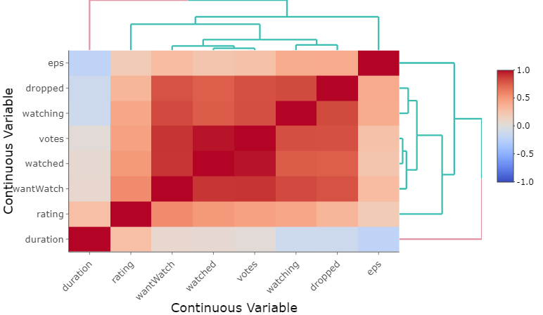
Bivariate Analysis

Slide 11
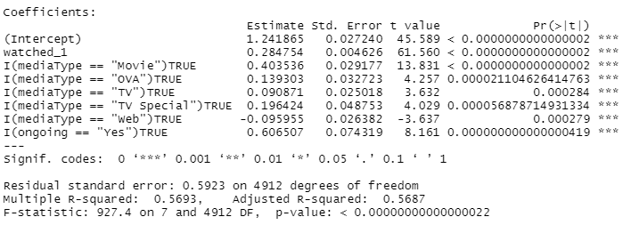
Model Building & Validation
Model Building
Model Validations
Goodness of Fit:
R-Squared: 0.5693
Adjusted R-Squared: 0.5687
Global Hypothesis:
P-Value less than 1% which implies that the model is viable.
The model accuracy of the linear regression on our dataset:
Mean Accuracy of Linear Regression Model is: 80.38%
Median Accuracy of Linear Regression Model is: 87.39%

Slide 12
Business Insights
Viewer who watched the animes are likely to impact the ratings in positively. This means with every 1 one person who completed watching the anime, the rating rises by 0.0028 units.
Anime which are ongoing have a positive impact on the rating. This means rating of the ongoing will be more by 0.00606 units than anime with are not.
The rating of an anime if the media type is “Movie”, will be more by 0.00403 units compared to the rating of the anime if the media type “DVD”.
The rating of an anime if the media type is “OVA”, will be more by 0.00139 units compared to the rating of the anime if the media type “DVD”.
The rating of an anime if the media type is “TV”, will be more by 0.000908 units compared to the rating of the anime if the media type “DVD”.
The rating of an anime if the media type is “TV Special”, will be more by 0.00196 units compared to the rating of the anime if the media type “DVD”.
The rating of an anime if the media type is “Web”, will be fall by 0.00095 units compared to the rating of the anime if the media type “DVD”.

Slide 13




Thank You
Dipanka Talukder
dipankat17@gmail.com
IVY Professional School

